Slide 1
Prof. Subodh Wagle, IIT Bombay
TD 638: Development Perspectives
Mock Test

Slide 2
Closed Book Exam Question: Examples

Slide 3
Quiz Questions
Fill in the blanks: (5 Minutes)
There is no economic component in the definition of this system: _____________
Transformation from subsistence agriculture to sheep-farming was part of transformation from _____________
to _____________
In the period under _____________, International trade was significant but restricted mainly to spices, precious metals, and luxury goods.
Words to fill in the blank spaces:
Capitalism, Imperialism, Mercantilism, Feudalism, Mercantilism, Feudalism, Imperialism (Not in the order obviously)

Slide 4
Answers to the Quiz Questions
Fill in the blanks: (5 Minutes)
There is no economic component in the definition of this system: Imperialism
Transformation from subsistence agriculture to sheep-farming was part of transformation from Feudalism to Capitalism.
In the period under Feudalism, International trade was significant but restricted mainly to spices, precious metals, and luxury goods.
Words to fill in the blank spaces:
Capitalism, Imperialism, Mercantilism, Feudalism, Mercantilism, Feudalism, Imperialism (Not in the order obviously)

Slide 5
Open Book Exam Question: Examples

Slide 6
Model Answers to Question 4
Open Book Exam: Question 1 (Marks 3) (Time 5 Minutes)
Question: Take More Time to Think and Form Your Answer, Write in Short
Please explain: How did colonialism help industrial capitalism in its early years? (Max Marks 3).
Write in not more than THREE bullet points. Each bullet point is one or two sentences, and not more than 40 words approximately.
Model Answer
Colonialism immensely helped industrial capitalism by providing natural resources from colonies free or at low costs.
Colonialism immensely helped industrial capitalism by providing captive markets in colonies to sell their production without competition and at high prices.
Colonialism immensely helped industrial capitalism by providing indentured labor to work at low wages on plantations owned by colonizers.

Slide 7
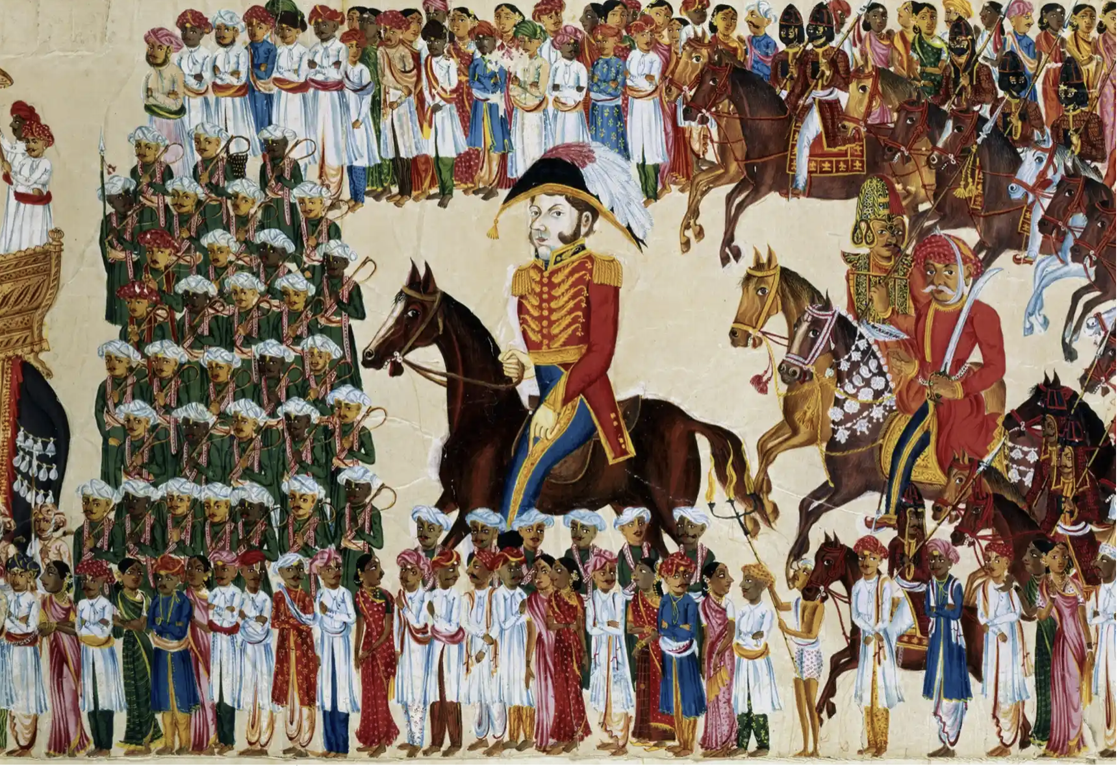

Slide 8
Open Book Exam: Question 2 (Marks 3) (Time 5 Minutes)
Answer the following questions (in that order):
What (one) element do you see in this picture that is relevant to what we studied in class?
(In the mid-sem exam, you may be given excerpts from some book or article instead of a picture.)
What concept / issue/ argument you learned in the course is RELATED to your answer to Q 1?
What exactly is the connection between your answers to Question 1 and Question 2?
What is the significance of your answer to Q 2 for the course about development perspective?
The answer to every question should not be more than one bullet point, with about 30 words.

Slide 9

What (one) element do you see in this picture that is relevant to what we studied in class?
What concept/issue/ argument you learned in the course is RELATED to your answer to Q 1?
What exactly is the connection between your answers to Question 1 and Question 2?
What is the significance of your answer to Q 2 for the course about development perspective?
Answer to every question should not be more than one bullet point with about 30 words.

Slide 10
Understanding Development: Different Basic Explanations
Answer the following questions (in that order):
What (one) element do you see in this picture that is relevant to what we studied in class?
Answer: One English military officer is shown BIG in size with small size figures of a large number of Indian people.
What concept / issue/ argument you learned in the course is RELATED to your answer to Q 1?
Answer: Colonialism = The political control of people and territories by foreign states.
What exactly is the connection between your answers to Question 1 and Question 2?
Answer: The BIG size English military officer represent British colonial power ruling over Indian people shown in small size.
What is the significance of your answer to Q 2 for the course about development perspective?
Answer: Collonialism left many legacy effect on India that affected its development.

